Slide 1
Kubernetes at war on Azure
Krzysztof Pudłowski
Łódź, 23.10.2019

Slide 2

About me…
Long-time corporate employee. Currently, he works in the telecommunications sector. Physicist by profession, education completed with a doctorate from the University of Łódź. Practical knowledge of enterprise software development. Administrator, developer, team leader, IT expert. He holds professional certificates: MCP, MCSA: SQL Server 2012/2014, MCSE: Data Management and Analytics, MCSA: Cloud Platform, MCSE: Cloud Platform and Infrastructure , MPP Data Science , Microsoft Certified: Azure Administrator Associate , Microsoft Certified: Azure Data Scientist Associate
Blogger at wchmurze.cloud

Slide 3
Be prepared to changes in Azure
Azure Kubernetes Service Changelog
Release 2019-10-14
This release is rolling out to all regions
Service Updates
With the official 2019-11-04 Azure CLI release, AKS will default new cluster creates to VM Scale-Sets and Standard Load Balancers (VMSS/SLB) instead of VM Availability Sets and Basic Load Balancers (VMAS/BLB).
From 2019-10-14 AKS Portal will default new cluster creates to VM Scale-Sets and Standard Load Balancers (VMSS/SLB) instead of VM Availability Sets and Basic Load Balancers (VMAS/BLB). Users can still explicitly choose VMAS and BLB.
From 2019-11-04 the CLI extension will have a new parameter --zones to replace --node-zones, which specifies the zones to be used by the cluster nodes.

Slide 4
Resources to read
https://bit.ly/2BIcEgd
https://github.com/djkormo/k8s-AKS-primer

Slide 5
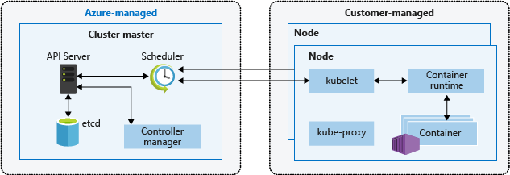
Kubernetes in 5 minutes
https://www.youtube.com/watch?v=PH-2FfFD2PU
Cluster master nodes provide the core Kubernetes services and orchestration of application workloads.
Nodes run your application workloads.

Slide 6
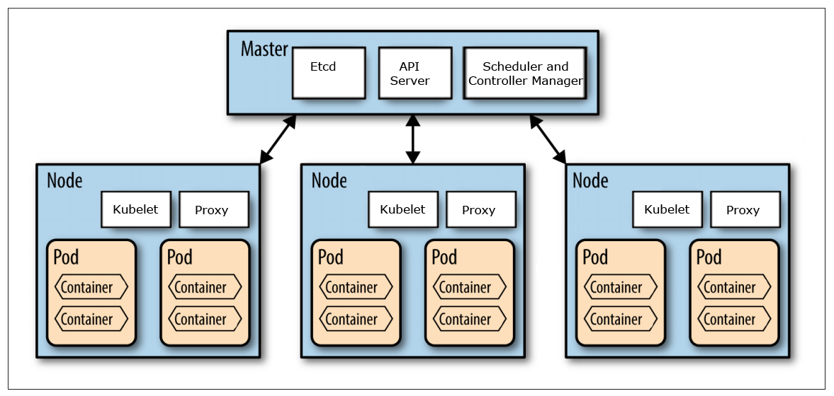
Kubernetes in 5 minutes

Slide 7
Kubernetes limits
At v1.16, Kubernetes supports clusters with up to 5000 nodes. More specifically, we support configurations that meet all of the following criteria:
No more than 5000 nodes
No more than 150000 total pods
No more than 300000 total containers
No more than 100 pods per node
https://kubernetes.io/docs/setup/best-practices/cluster-large/

Slide 8
Limits, requests
Kubernetes employs requests and limits to control resources. Requests are guaranteed resources that a container is entitled to use. Limits, on the other hand, are the maximum resources or threshold a container can use.
After reaching the limits, containers will be restricted. If a container requests a resource, Kubernetes will only schedule it on an available node that can provide those resources. These resources and limit are defined in the standard YAML configuration of your containers.
In Kubernetes, there are two types of resources: CPU and Memory. CPU is measured in core units, and memory is specified in bytes.

Slide 9
CPU
CPU resources are measured in millicore. If a node has 2 cores, the node’s CPU capacity would be represented as 2000m. The unit suffix m stands for “thousandth of a core.”
1000m or 1000 millicore is equal to 1 core. 4000m would represent 4 cores. 250 millicore per pod means 4 pods with a similar value of 250m can run on a single core. On a 4 core node, 16 pods each having 250m can run on that node.

Slide 10
Memory
Memory is measured in bytes. However, you can express memory with various suffixes (E,P,T,G,M,K and Ei, Pi, Ti, Gi, Mi, Ki) to express mebibytes (Mi) to petabytes (Pi). Most simply use Mi.
Like CPU, pods will never be scheduled if they require more resources than the capacity of a node. Unlike CPU, memory is not compressible. You can’t make memory run slower or faster like CPU or network throttling. Pods will be terminated if it reaches the memory limit.

Slide 11
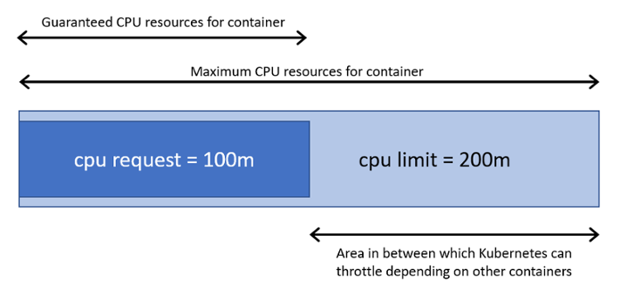
Limits, requests
https://jaxenter.com/manage-container-resource-kubernetes-141977.html
https://vincentlauzon.com/2019/04/02/requests-vs-limits-in-kubernetes/

Slide 12
Container limits
apiVersion: v1
kind: Pod
metadata:
name: pod-quota-1
spec:
containers:
- name: pod-quota-1
image: nginx
apiVersion: v1
kind: Pod
metadata:
name: pod-quota-2
spec:
containers:
- name: pod-quota-2
image: redis
resources:
limits:
memory: "1Gi"
cpu: "800m"
requests:
memory: "700Mi"
cpu: "400m"

Slide 13
Namespaces
Beyond the individual container resources, you may want to investigate setting limits on namespaces. So what is a namespace? Namespaces can be used to define a cluster of applications, departments, or environments. Simply, Namespace refers to scope or grouping of objects in a Kubernetes cluster
At the Namespace level, you can set up ResourceQuotas and LimitRanges.

Slide 14
Resource quota
apiVersion: v1
kind: ResourceQuota
metadata:
name: compute-resources
spec:
hard:
pods: "20"
requests.cpu: "1"
requests.memory: 1Gi
limits.cpu: "2"
limits.memory: 2Gi
requests.nvidia.com/gpu: 3
https://github.com/djkormo/k8s-AKS-primer/tree/master/examples/quotas

Slide 15
Limit range
apiVersion: v1
kind: LimitRange
metadata:
name: limit-mem-cpu-per-container
spec:
limits:
- max:
cpu: "800m"
memory: "1Gi"
min:
cpu: "50m"
memory: "50Mi"
default:
cpu: "200m"
memory: "200Mi"
defaultRequest:
cpu: "100m"
memory: "100Mi"
type: Container

Slide 16
Resources quota/limit range
DEMO

Slide 17
Resource quotas
apiVersion: v1
kind: ResourceQuota
metadata:
name: compute-resources
spec:
hard:
pods: "20"
requests.cpu: "1"
requests.memory: 1Gi
limits.cpu: "2"
limits.memory: 2Gi
requests.nvidia.com/gpu: 3

Slide 18
Nodes limits
kubectl describe node
kubectl top nodes
kubectl top pods --all-namespaces

Slide 19
Node limits
https://github.com/Azure/aks-engine/blob/master/docs/topics/clusterdefinitions.md
"--max-pods" | "30", or "110" if using kubenet --network-plugin (i.e., "networkPlugin": "kubenet")
"--node-monitor-grace-period" | "40s"
"--pod-eviction-timeout" | "5m0s"

Slide 20
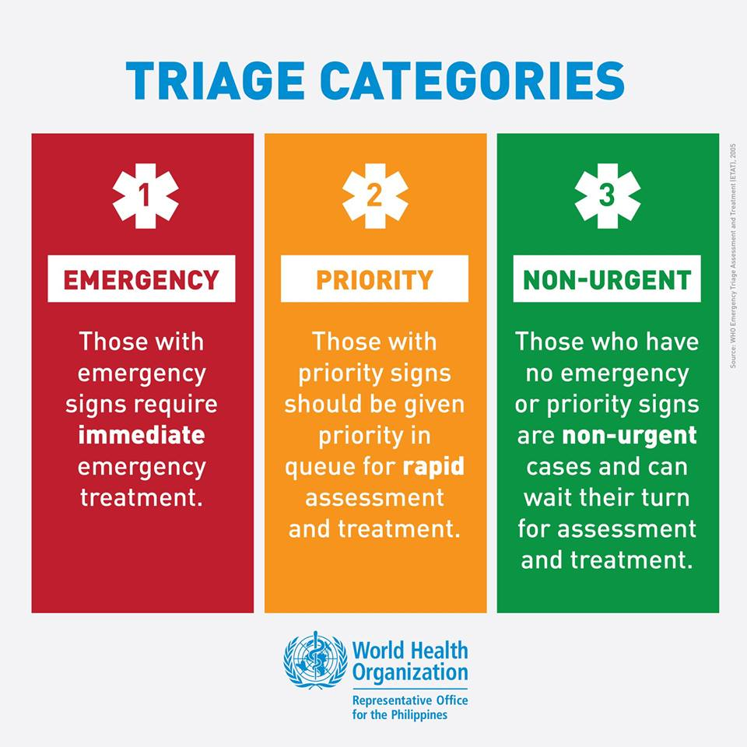
Triage

Slide 21

Scheduler and QoS
QoS (Quality of Service) Classes
When Kubernetes creates a pod, it assigns one of these three QoS classes:
Guaranteed
Burstable
BestEffort

Slide 22
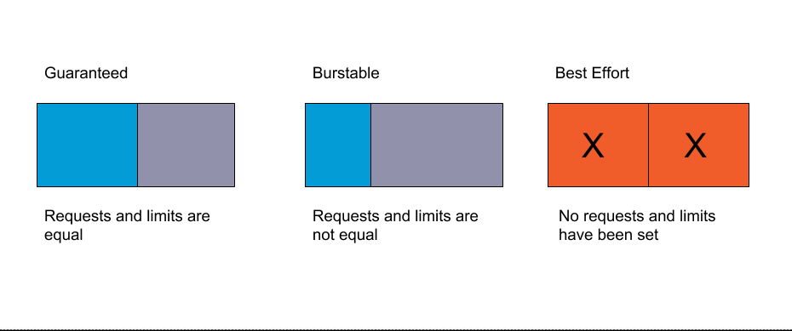
Quality of Service (QoS)
https://www.weave.works/blog/kubernetes-pod-resource-limitations-and-quality-of-service

Slide 23
Guaranteed QoS
For a Pod to be given a QoS class of Guaranteed:
Every Container in the Pod must have a memory limit and a memory request, and they must be the same.
Every Container in the Pod must have a CPU limit and a CPU request, and they must be the same.
resources:
limits:
memory: "200Mi"
cpu: "700m"
requests:
memory: "200Mi"
cpu: "700m"
https://kubernetes.io/docs/tasks/configure-pod-container/quality-service-pod/#create-a-pod-that-gets-assigned-a-qos-class-of-guaranteed

Slide 24
Burstable QoS
Burstable class have two conditions:
They don’t meet the QoS guaranteed criteria.
They have at least one memory or CPU request.

Slide 25
BestEffort QoS
BestEffort is a container with no memory or CPU limits or requests. If you’ve never defined any resources before reading this, your pod is by default running in BestEffort.
Simply, BestEffort is when you don’t set anything at all.

Slide 26
Quality of Service Best Practices
For production workloads, BestEffort is not recommended. Keep in mind, these containers will be killed first. Burstable is suitable for most generic workloads. For sensitive applications that may have spikes or anything that runs in a stateful set like databases, it is recommended to apply a QoS guaranteed class.

Slide 27
Node Failure
This is the workflow of what happens when a node gets down:
1- The Kubelet posts its status to the masters using –node-status-
update-frequency=10s
2- A node dies
3- The kube controller manager is the one monitoring the nodes, using –-node-monitor-period=5s it checks, in the masters, the node status reported by the Kubelet.
4- Kube controller manager will see the node is unresponsive, and has this grace period –node-monitor-grace-period=40s until it considers the node unhealthy. This parameter must be N times node-status-update-frequency being N the number of retries allowed for the Kubelet to post node status. N is a constant in the code equals to 5

Slide 28
Failure
DEMO
https://github.com/djkormo/k8s-AKS-primer/tree/master/examples/failure

